Slide 1
Unit 3

Slide 2
Scan Line Polygon Filling Algorithm

Slide 3
Basic principles
The scan line polygon area filling algorithm calculates the intersection of the scan line and the polygon in the scan line order (from bottom to top), and displays the pixels of these intervals in the required color, that is, the filling work is completed.

Slide 4
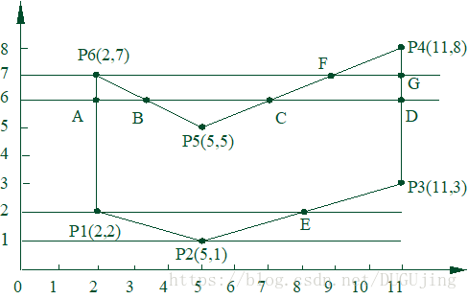

Slide 5
The endpoint of the interval can be obtained by calculating the intersection of the scan line and the polygon boundary line.
For a scan line, the polygon fill process can be divided into four steps:
(1) Intersection: Calculate the intersection of the scan line and each side of the polygon;
(2) Sorting: Sort all intersections in increasing order of x values;
(3) Pairing: first and second, third and fourth, etc.; each pair of intersections represents an intersection of the scan line and the polygon;
(4) Filling: set the pixels in the intersecting interval to a polygon color;

Slide 6
Ref video link
https://youtu.be/pIHZ70nsJBg
https://youtu.be/PZZA92YS9do

